Slide 1
Demand Management
FISCAL POLICY
3.6
Copyright Bananaomics

Slide 2
Disccussion!
Who controls monetary policy and what are their tools?
Copyright Bananaomics

Slide 3
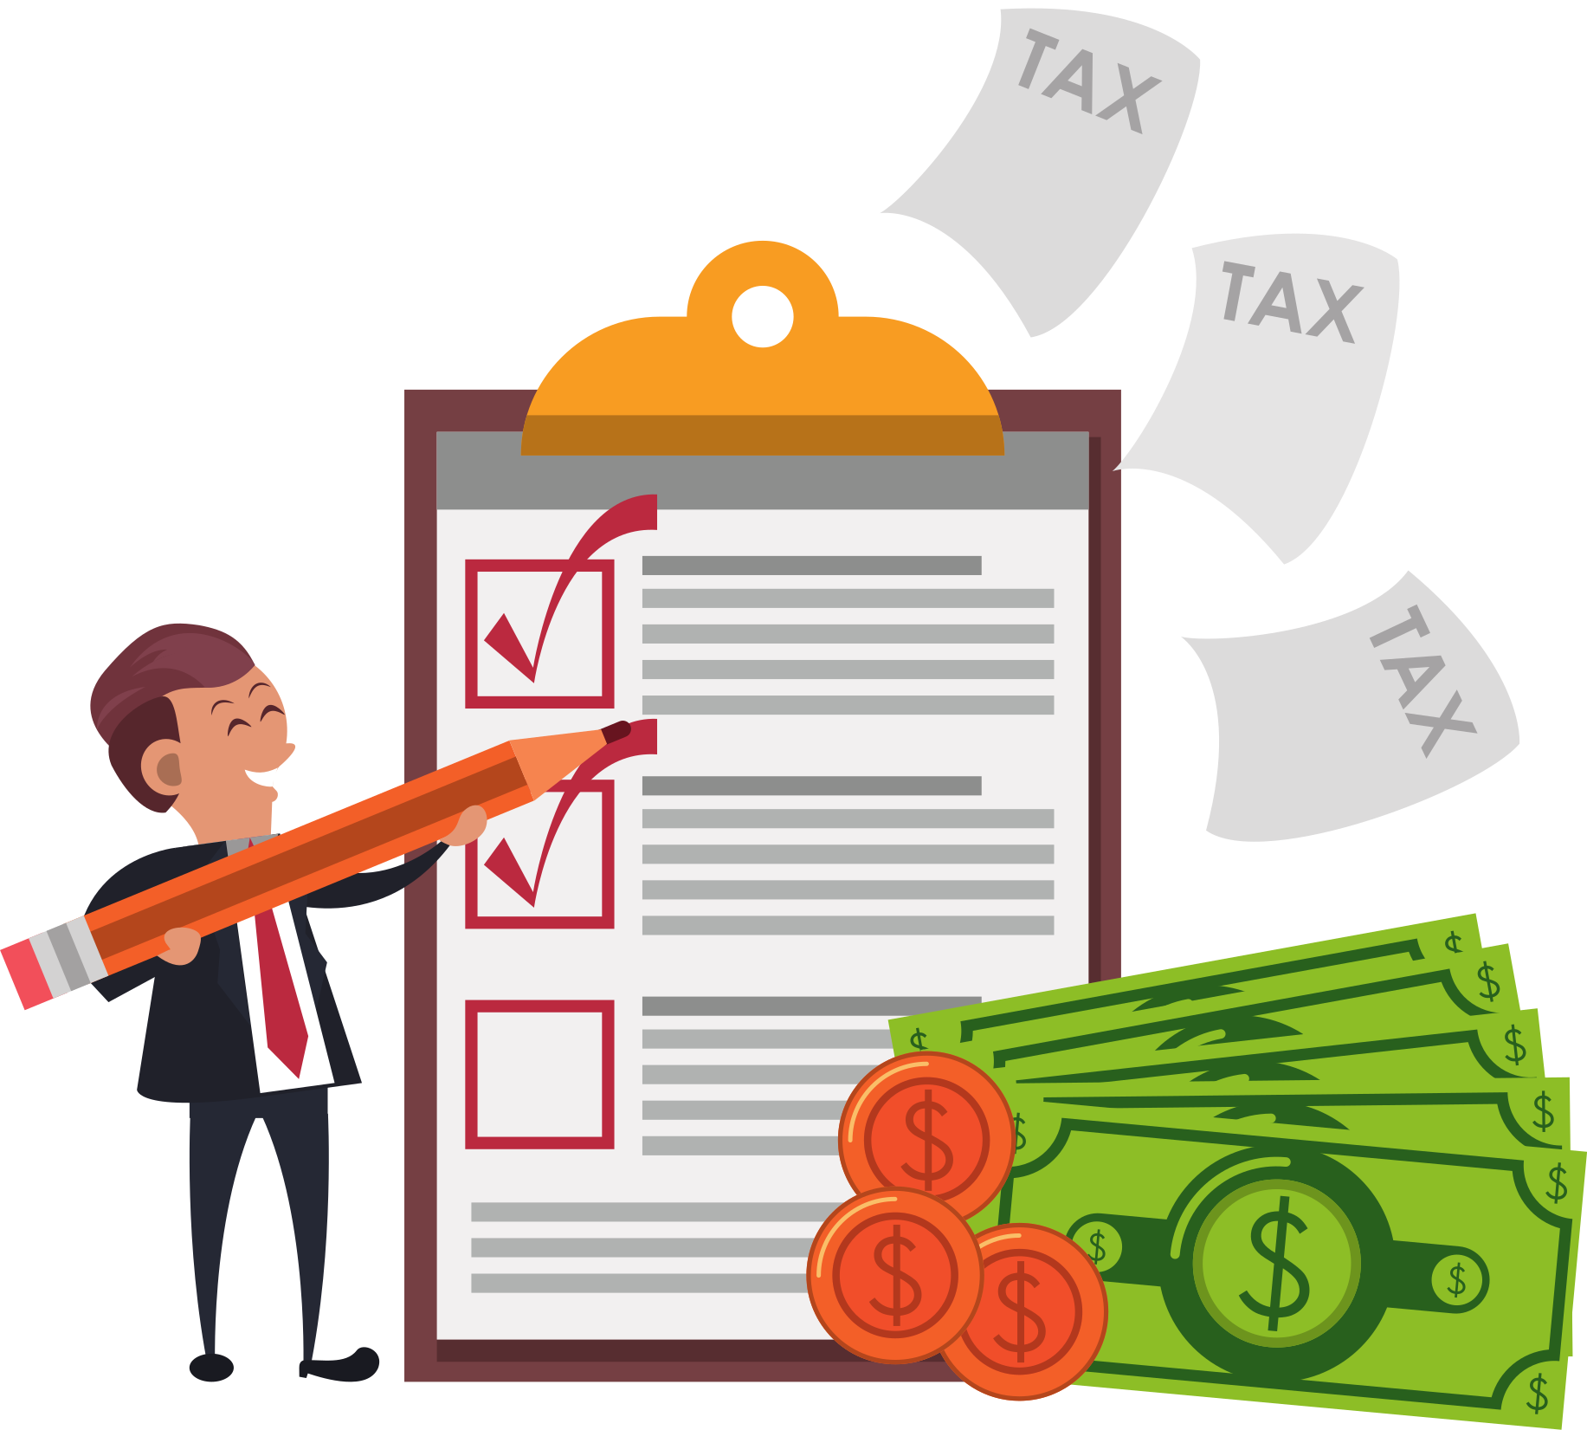
Definition
Fiscal Policy
The term for when the government intervenes in the market using taxation or government spending.
Copyright Bananaomics

Slide 4
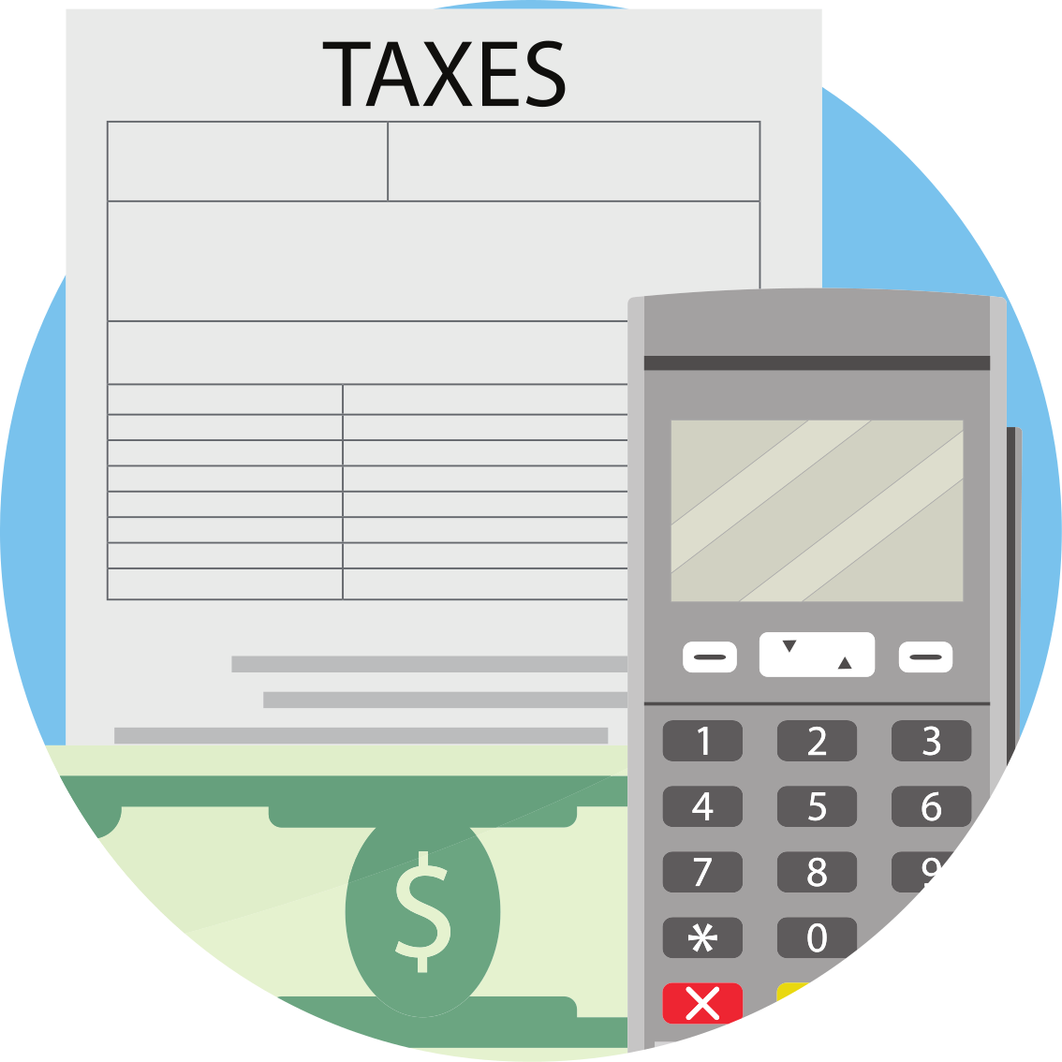
The Two Tools of Fiscal Policy
Taxes
Government Spending
Copyright Bananaomics

Slide 5
Definition
Budget
The government creates a budget yearly that outlines their revenue and how they plan to spend money.
Budget Deficit = Government Spending > Government Revenue
Budget Surplus = Government Spending < Government Revenue
Balanced Budget = Government Spending = Government Revenue
Copyright Bananaomics

Slide 6
Government Revenue Resources
Direct and Indirect Taxation
Direct taxes such as income taxes and indirect taxes such as sales tax, provides the government with revenue.
Sale of state-owned goods/services
State-owned businesses or enterprises often gain revenue such as airlines, postal services, or oil companies.
Selling state-owned assets
Privatisation: The process of transferring ownership of a firm to the private sector from the government.
Copyright Bananaomics

Slide 7
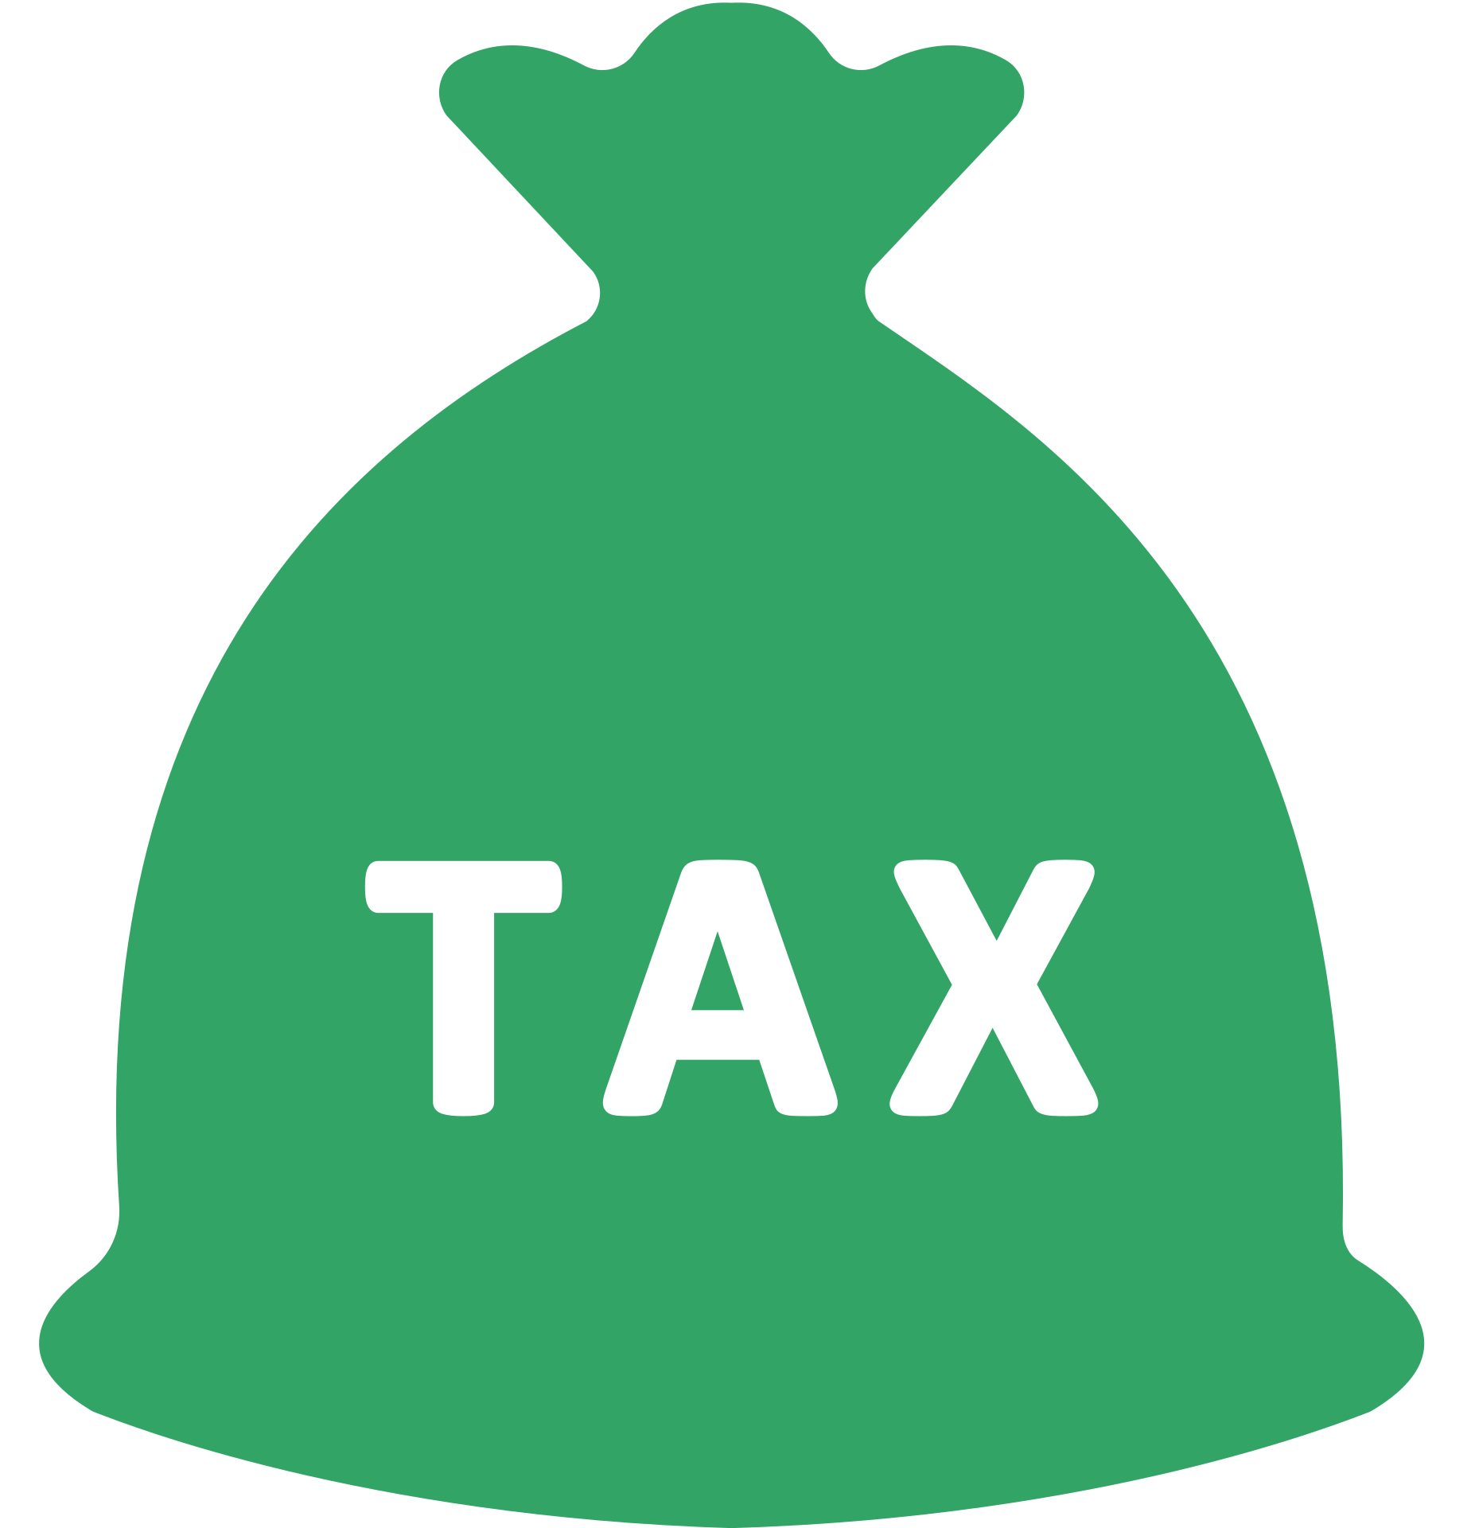
Types of Taxes
Direct Taxes
Taxes placed directly on individuals are typically placed on income and wealth paid directly to the government. (Examples: income tax, corporate taxes, wealth taxes)
Indirect Taxes
Taxes placed on spending on goods and services paid indirectly to the government. (Examples: sales tax, VAT, Goods and Servies Tax (GST), tariffs)
Copyright Bananaomics

Slide 8
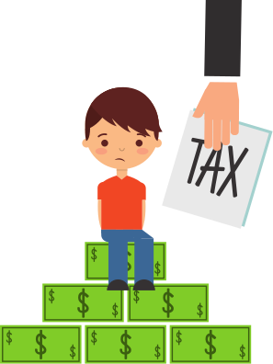
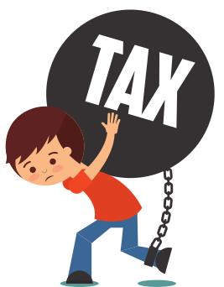
Progressive, Regressive, and Proportional
All taxes can be placed into one of three categories
Progressive Taxes
Taxation where the fraction/proportion of tax paid increases as income increases.
Regressive Taxes
Taxation where the fraction/proportion of tax paid increases as income decreases. All indirect taxes are regressive.
Proportional Taxes
A system of taxation where tax is levied at aconstant rate as income rises.
Copyright Bananaomics

Slide 9
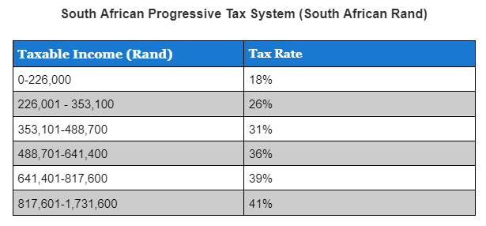
Progressive Tax Bracket
Most income taxes are progressive.
Copyright Bananaomics

Slide 10
Practice
Calculate how much each taxpayer pays in this system
Sam: 300,000 Rand
Mohammed: 490,000 Rand
Copyright Bananaomics

Slide 11
Practice
Calculate how much each taxpayer pays in this system
Sam - 300,000 Rand
Mohammed - 490,000 Rand
59,920 Rand in Taxes
116,230 Rand
Copyright Bananaomics

Slide 12
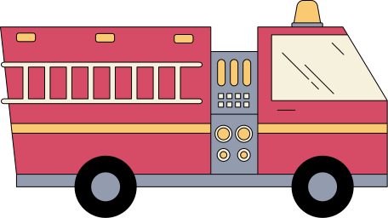
Government Spending
Current Expenditures
The daily cost of keeping the government operational (salaries, armed forces, supplies)
Capital Expenditures
The sum of all building and infrastructure financed by the government (public schools, fire stations, roads, hospitals)
Transfer Payments
A singular type of payment from the government to individuals typically to redistribute income or aid citizens (child support, unemployment payments, COVID stimulus payments)
Copyright Bananaomics

Slide 13
The Goals of Fiscal Policy
Copyright Bananaomics

Slide 14
Goals of Fiscal Policy
Similar to Monetary Policy
Low and stable inflation, low unemployment, promoting a stable environment for economic growth, reducing business cycle fluctuations, external balance
Equitable Distribution of Income
Through a progressive direct tax system and indirectly taxing luxury goods, the government can improve the distribution of income.
Copyright Bananaomics

Slide 15
Expansionary and Contractionary Fiscal Policy
Copyright Bananaomics

Slide 16
Connections!
Draw the business cycle and label how the government would use the2 tools of fiscal policy to meet their goals.
Copyright Bananaomics

Slide 17
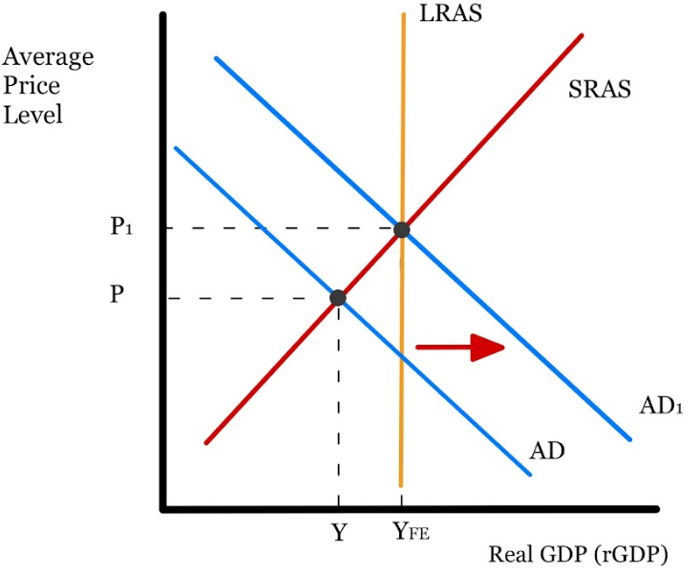
Expansionary Fiscal Policy
Taxes
Government Spending
To correct a recessionary gap, governments would possibly use expansionary fiscal policy to increase Aggregate Demand.
Copyright Bananaomics

Slide 18
Discussion!
Why wouldn't a government use expansionary fiscal policy to correct a recessionary gap?
Copyright Bananaomics

Slide 19
Remember!
Keynesian vs New Classical (Monetarists)
Copyright Bananaomics

Slide 20
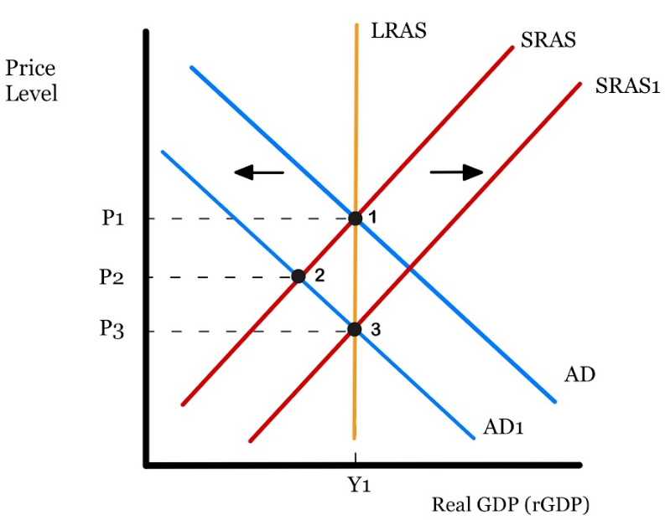
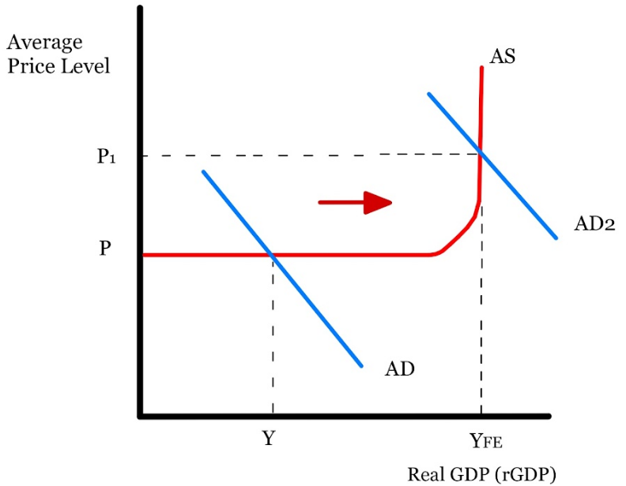
Closing Deflationary Gap
New Classical
Keynesian
Believes that the market will always automatically adjust back to equilibrium. Due to flexible wages, no government intervention is needed.
Believes the economy is not self-correcting. Due to 'sticky' wages, government intervention is required to move the economy back to full employment.
Copyright Bananaomics

Slide 21
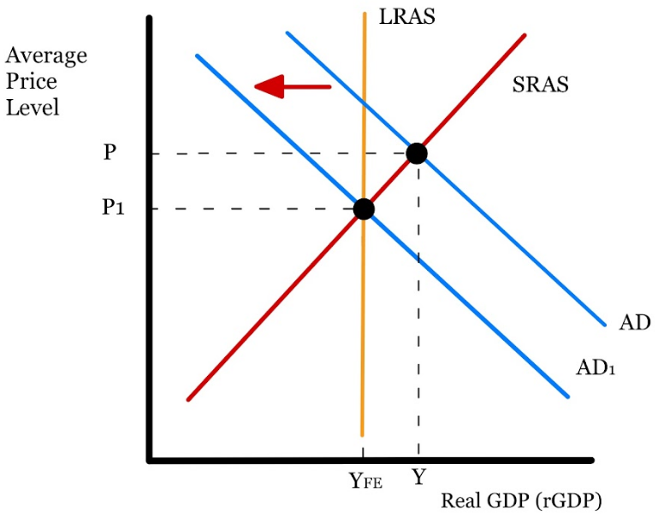
Contractionary Fiscal Policy
Taxes
Government Spending
To correct an inflationary gap, governments would possibly use contractionary fiscal policy to decrease Aggregate Demand.
Copyright Bananaomics

Slide 22
Discussion!
How would a Monetarist fix an inflationary gap? How would a Keynesian?
Copyright Bananaomics

Slide 23
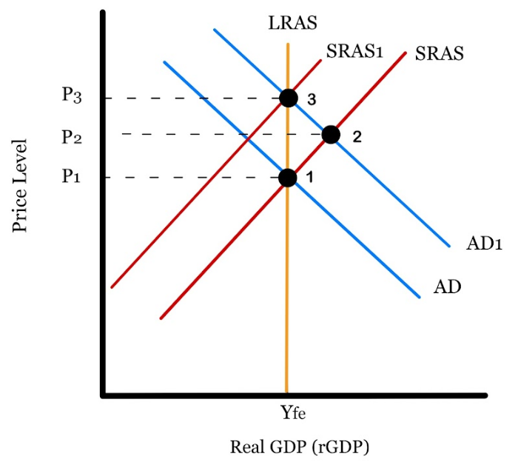
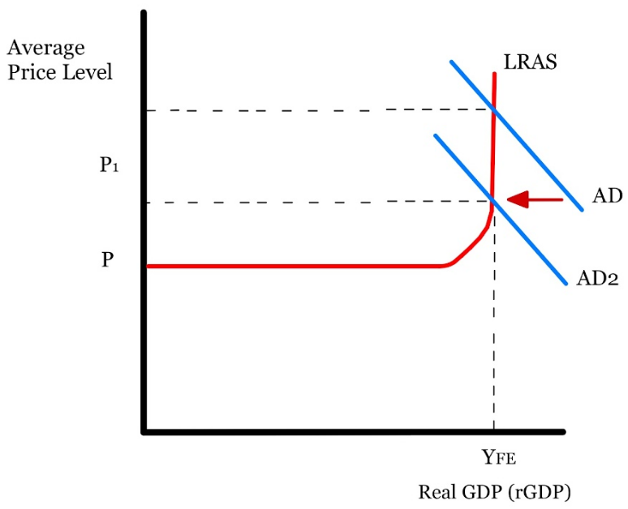
Closing Inflationary Gap
New Classical
Keynesian
Believes that an inflationary gap only occurs in the short-run and the market will always automatically adjust back to equilibrium. Due to flexible wages, no government intervention is needed.
Believes the economy is not self-correcting. Any attempt for output to increase beyond full employment furthers inflation. Government intervention is needed to limit inflation and return to full employment output.
Copyright Bananaomics

Slide 24
Keynes vs Hayek
Exploration Task
Click on the NPR image above and you will find a 20 minute podcast and a music video dealing with Keynes (Keynesian) vs Hayek (Neo-Classical).
As you listen to the podcast and video, take notes regarding Keynes on one side and Hayek on the other.
Copyright Bananaomics

Slide 25
Keynesian Multiplier(HL Only)
Copyright Bananaomics

Slide 26
Discussion!
What is the effect of the government spending $100 Million?
Copyright Bananaomics

Slide 27
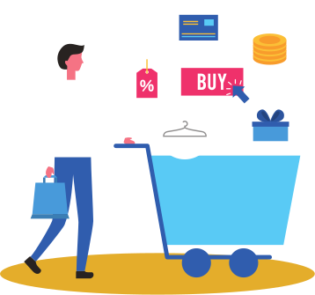
Circular Flow and Government Spending
Scenario: Building a new school
The government contracts out this building and hires a construction company.
This construction company must then purchase resources to build this school.
Additionally, they hire more employees for the job.
Households now receive more income. Households will either spend or save that income.
Marginal Propensity to Save
Marginal Propensity to Consume
MPS is the proportion of income that households choose to save.
MPC is the proportion of income that households choose to spend.
Copyright Bananaomics

Slide 28
Circular Flow and Government Spending
Assume households MPC = 30% or .3
Households spend 30% of the additional income they receive (.3*100 = $30 million)
Firms now must adjust their inventory due to the increase in spending. This requires more Factors of Production be purchased.
Households now have additional income and are now spending an additional (.3 * 30 = $9 million)
This chain reaction would continue until the $100 Million initial government spending results in a total change of $142 Million.
The Multiplier Effect
Copyright Bananaomics

Slide 29
Multiplier Effect
Khan Academy
Copyright Bananaomics

Slide 30
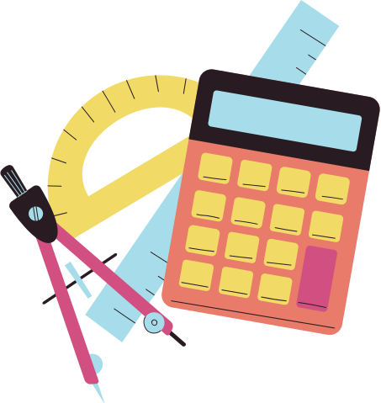
Keynesian Multiplier
1
Multiplier
1 - MPC
1
1
Example MPC = .5
2
1 - MPC
1 - .5
Copyright Bananaomics

Slide 31
Practice
Calculate the multiplier for each of the following
MPC = .2 (20%)
MPC = .8 (80%)
MPC = .4 (40%)
MPC = 0 (0%)
Copyright Bananaomics

Slide 32
Practice
Calculate the multiplier for each of the following
MPC = .2 (20%)
MPC = .8 (80%)
MPC = .4 (40%)
MPC = 0 (0%)
1.25
5
1.66
1
Copyright Bananaomics

Slide 33
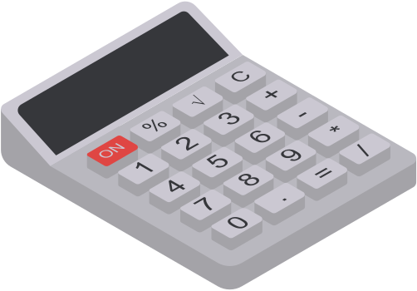
Keynesian Multiplier
There is an alternative way to measure the multiplier that is more accurate.
1
Multiplier
MPS + MPT + MPM
Marginal Propensity to Tax (MPT) - proportion of additional income that is taxed.
Marginal Propensity to Import (MPM) - proportion of additional income that is spent on imports.
Example: MPS = 10% ; MPT = 30% ; MPM = 0%
Multiplier
1
2.5
.1 + .3 + 0
Copyright Bananaomics

Slide 34
Practice
Calculate the multiplier for each of the following
MPS = .1 ; MPT = .1; MPM = 0
MPS = 20% ; MPT = 20%; MPM = 40%
MPS = .3 ; MPT = .1; MPM = .1
Copyright Bananaomics

Slide 35
Practice
Calculate the multiplier for each of the following
MPS = .1 ; MPT = .1; MPM = 0
MPS = 20% ; MPT = 20%; MPM = 40%
MPS = .3 ; MPT = .1; MPM = .1
5
1.25
2
Copyright Bananaomics

Slide 36
Keynesian Multiplier
How to calculate the change in GDP?
Change in GDP
the multiplier
X
the change in expenditure
Calculate the change in GDP for each of the following
MPC = .5 and increase of $200 million
MPC = .8 and increase of $20 million
MPS = .2; MPT = .4; MPM = .2; and increase of 20 million
Copyright Bananaomics

Slide 37
Keynesian Multiplier
How to calculate the change in GDP?
Change in GDP
the multiplier
X
the change in expenditure
Calculate the change in GDP for each of the following
MPC = .5 and increase of $200 million
MPC = .8 and increase of $20 million
MPS = .2; MPT = .4; MPM = .2; and increase of 20 million
$400 Million
$100 Million
$25 Million
Copyright Bananaomics

Slide 38
Crowding Out (HL Only)
Copyright Bananaomics

Slide 39
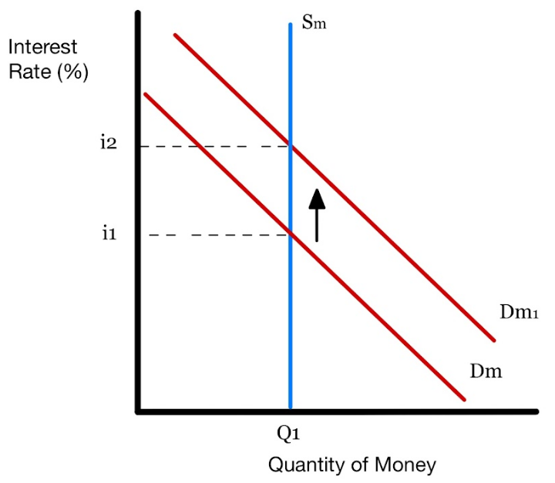
Crowding Out
When public sector (government) spending drives down private sector spending (consumption and investment).
If the government decides to build a new school, they must increase their spending. What is the impact of this on AD/AS?
The government must demand more money resulting in an increase to the overall interest rate.
As interest rates rise, firms will find it too expensive to invest in new projects and spending. This results in a decrease in consumption and investment.
Copyright Bananaomics

Slide 40
Crowding Out
What is crowding out? - Marginal Revolution University
Copyright Bananaomics

Slide 41
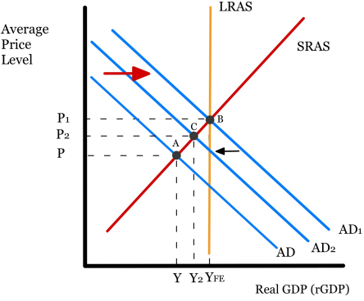
Crowding Out
Fiscal policy should lead to a readjustment of AD to equilibrium (AD -> AD1).
However, due to crowding out, Investment and Consumption fall resulting in a decrease to AD2.
Copyright Bananaomics

Slide 42
Automatic Stabilizers (HL Only)
Copyright Bananaomics

Slide 43
Automatic Stabilizers
Features in an economy that reduce business cycle fluctuations without any government intervention. They occur automatically.
Common Automatic Stabilizers
Progressive Income Taxes
Unemployment Benefits
Copyright Bananaomics

Slide 44
Discussion!
Discuss how progressive income taxes and unemployment benefits may help stabilize the economy.
Copyright Bananaomics

Slide 45
Automatic Stabilizers Functionality
Economic Recession
Unemployment rises and the government spends more on unemployment benefits.
For those that keep their jobs, wages fall with Average Price Level. Lower wages push individuals into a lower tax bracket, allowing them to save money. (If in a progressive system)
Less government tax revenue
A rise in government spending and a decrease in taxes create economic growth to combat the recession
Copyright Bananaomics

Slide 46
Automatic Stabilizers Functionality
Economic Boom/Expansion
Unemployment falls and the government spends less on unemployment benefits.
As individuals are hired and receive an increase in wages, they are pushed into a higher tax bracket meaning that they pay more income tax. (If in a progressive system)
Increase government tax revenue
A decrease in government spending and an increase in taxes will slow down the economy to combat the inflation and return to Full Employment
Copyright Bananaomics

Slide 47
Fiscal Policy Strengths
Copyright Bananaomics

Slide 48
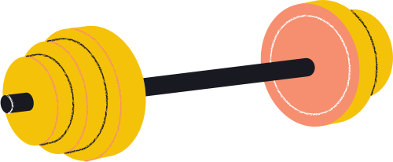
Fiscal Policy Strengths
Able to target specific sectors of economy
Effective in a recession (automatic stabilizers)
Direct impact of AD
Government intervention is required for Keynesian view
Copyright Bananaomics

Slide 49
Fiscal Policy Limitations
Copyright Bananaomics

Slide 50
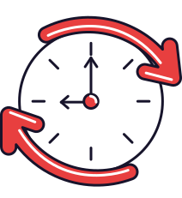
Limitations of Fiscal Policy
Politics
Differing political parties have different beliefs on what is best for the economy. These differences frequently lead to longer response times.
Time Lags
The government takes time to notice a problem, develop a policy, and then implement that policy. These policies take time to be effective.
Sustainable Debt
Governments must spend money to stimulate the economy if needed. These expenditures compile and may turn into large amounts of debt.
Crowding Out
When public sector (government) spending drives down private sector spending (consumption and investment).
Copyright Bananaomics

Slide 51
Practice Question
Copyright Bananaomics

Slide 52
Paper 1
M18/3/ECONO/HP1/ENG/TZ1/XX
(a) Explain how expansionary fiscal policy could be used to close a deflationary (recessionary) gap. [10]
Copyright Bananaomics

Slide 53
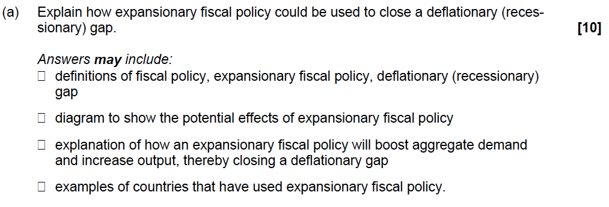
Mark Scheme
Copyright Bananaomics

Slide 54
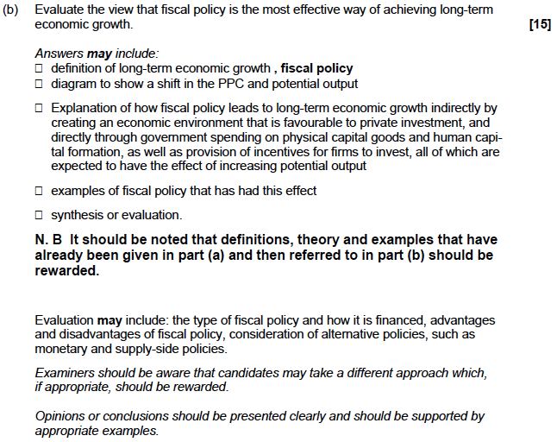
Mark Scheme
Copyright Bananaomics

Slide 55
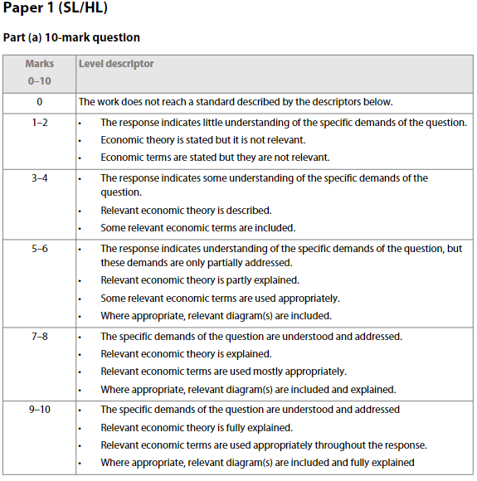
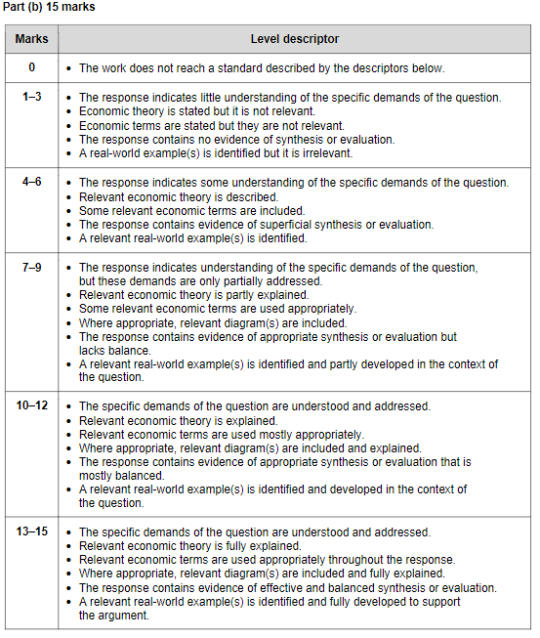
Mark Scheme
Copyright Bananaomics

Slide 56
Enjoying The Content?
Visit bananaomics.com to purchase package deals with discount prices!
BANANAOMICS

